Slide 1


INFO 6150 --- Final Project
Movie World
T e a m : MIC
Member: Xuhang Liu
Zhe Xu
Yuhuizi Rao
Hsiang-Hua Chen

Slide 2
CONTENT
公众账号基本信息介绍
Methodology
Breakdown
Approach
图文信息统计分析
1
2
3
4
商业软文信息统计分析
Problem Statement
Key Functionalities
总结

Slide 3
1
Movie World
Problem Statement
Final Project Overview

Slide 4
Final Project Overview -- Problem Statement
Stepping in a new era of digital media, people find it more convenient to expand their horizons using internet.
Todays information on internet: better security, interactivity and trackability
Movies:
A
What are the good movies?
B
What movies do I like?
C
What is my taste in movies?
D
How can I contribute?

Slide 5
Final Project Overview -- Problem Statement
Movie-based website:
Informative, neat, user-friendly
A
Ecosystem and reusability
B
Account safety
C
Information management
D
Expansion and exploration

Slide 6
2
Movie World
Approach

Slide 7
Approach
Movie World:
A movie review & collection website
Angular Cli 6
NodeJS
MongoDB

Slide 8
3
Movie World
Key Functionalities

Slide 9

Account Management
Register
Login
Update profile
Change password
Collection Management
Add favorite movie to personal “Like”list
Remove from “Like”list
See what movie has been liked in home page
Browse Movies Info
Filters
Direct search
View details
Share& Explore
Share movie info via Twitter & Facebook
Explore nearby theaters based on users location
Key Functionalities

Slide 10
4
Movie World
Methodology Breakdown

Slide 11


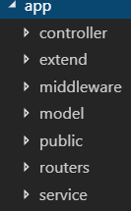
Back End
Designed REST API:
Controller
Model
Routers
Service
+
Middleware:
Handling request responses
Handling errors
Improve development &
validation process

Slide 12
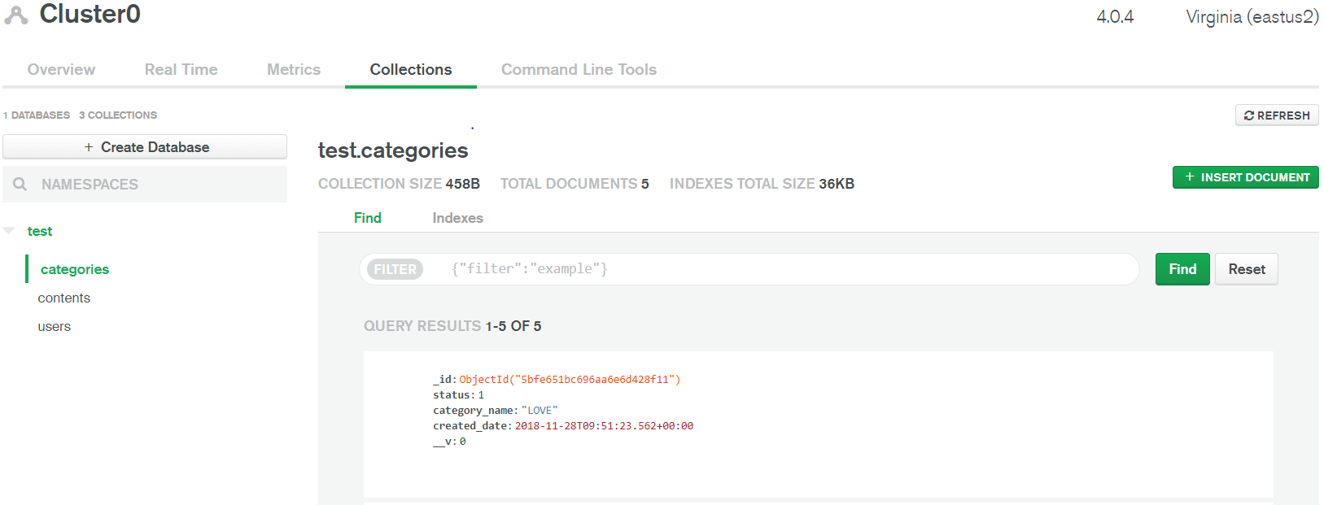
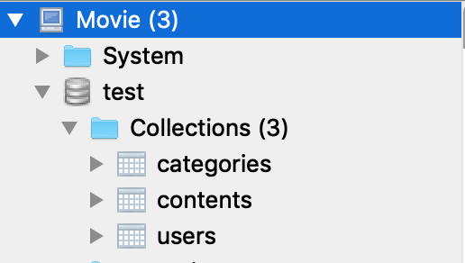
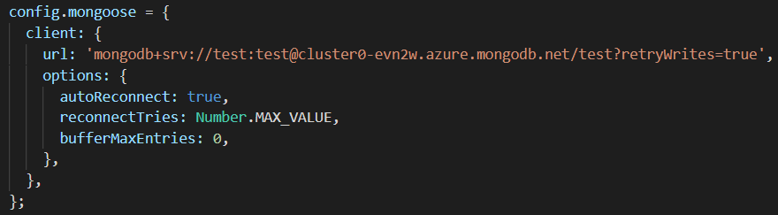
Back End
3 Types of Collections:
Category
Content
User

Slide 13
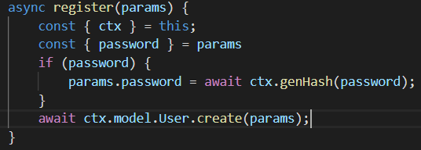
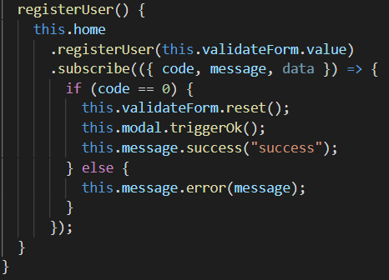
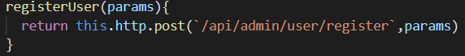
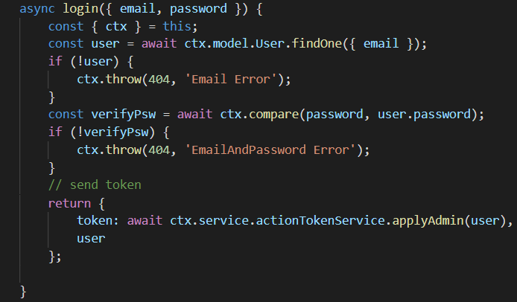
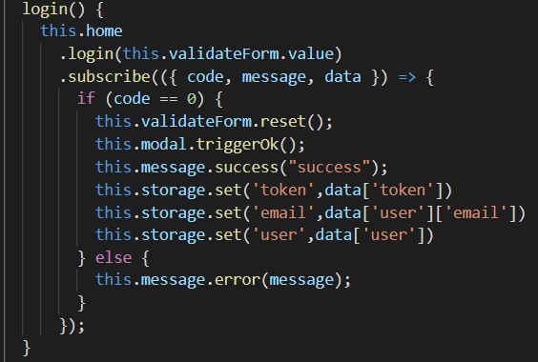
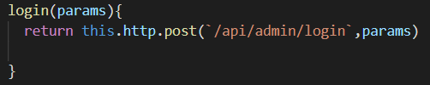
Front End
User account management
Register
NodeJS
Login

Slide 14
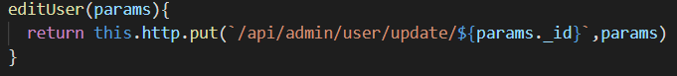
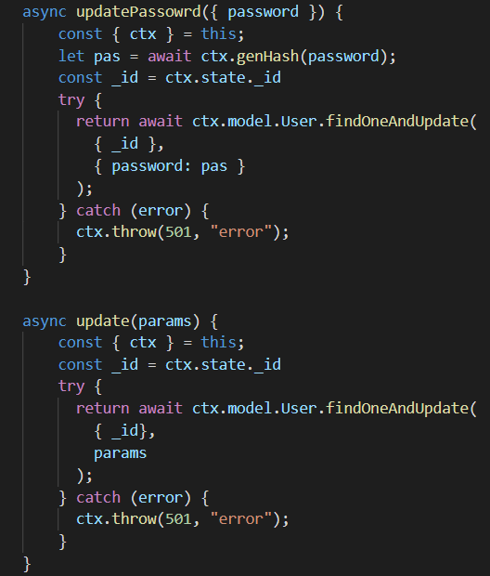
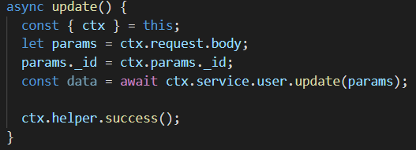
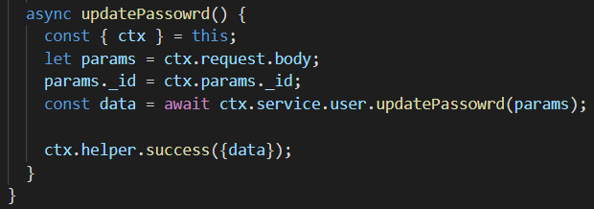
Front End
User account management
NodeJS
Update Profile
Change Password

Slide 15
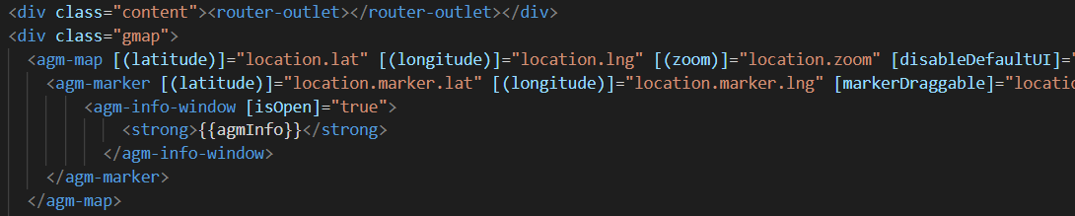
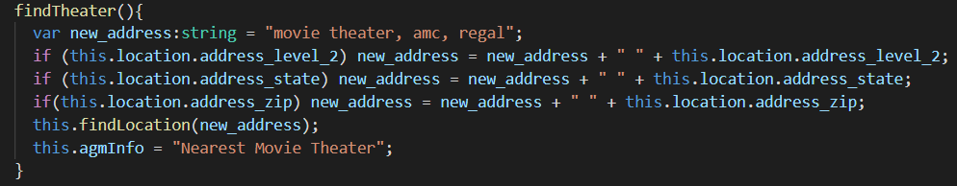
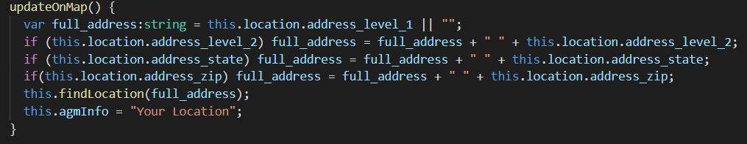
Front End
Share & Explore
GoogleMapsAPIWrapper & AgmCoreModule
Generate map according to user’s location in record
Explore theaters near me
Drag & drop change location

Slide 16
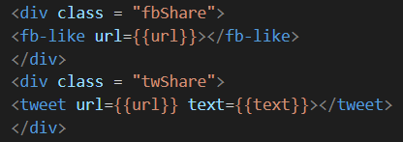
Front End
Share & Explore
JwSocialButtonsModule
Direct to Twitter, allow to share
Direct to Facebook, allow to share and like

Slide 17
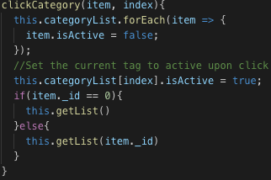
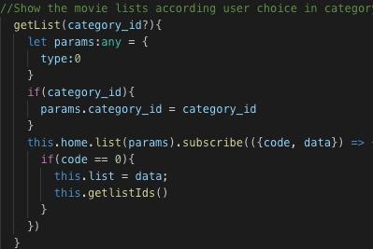
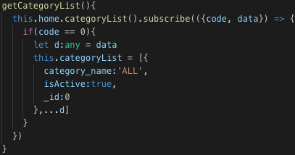
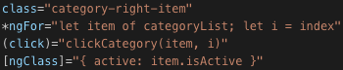
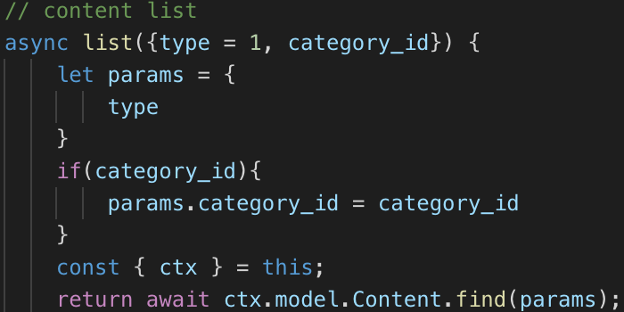
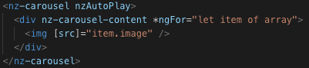
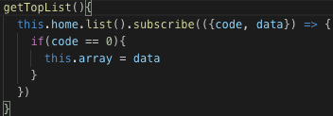
Front End
Browsing movie(s) info
Return movie Item(s)
Populate Category List
mongoDB
Carousel Display
Categories[index]
isActive = true
Categories
(id matched)
Movie items list

Slide 18
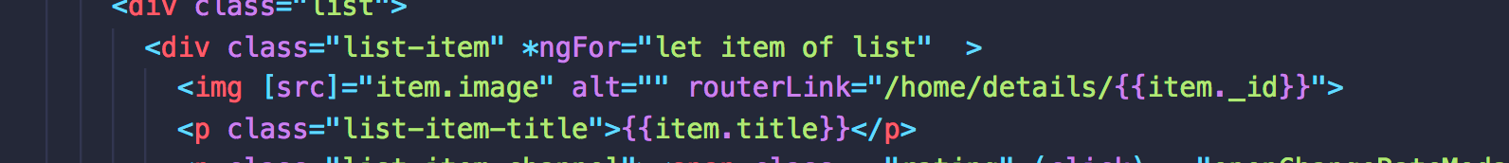



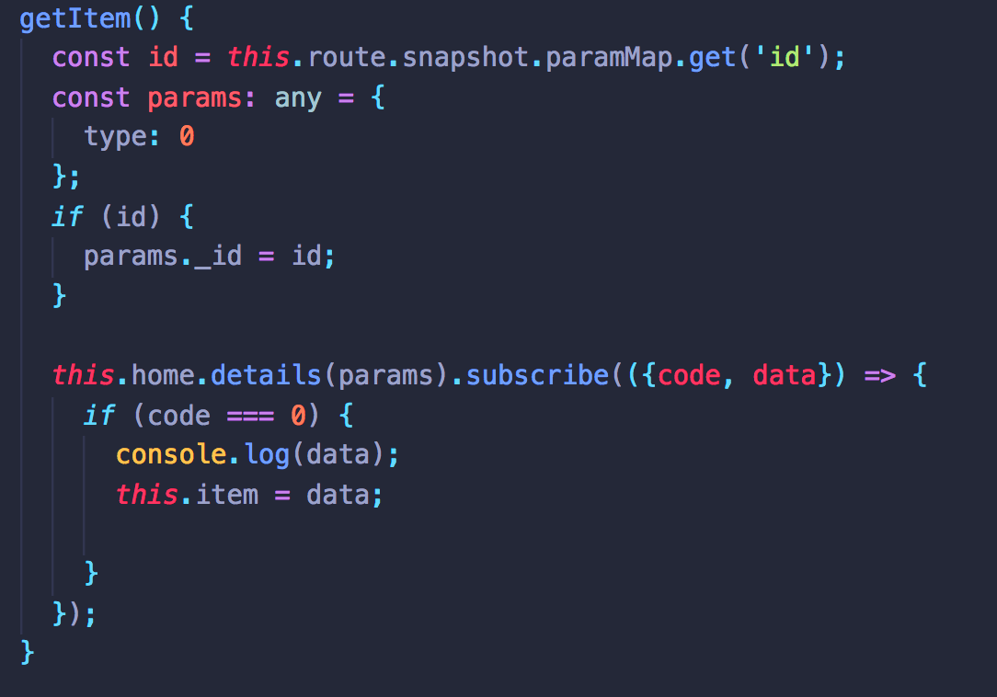
Front End
View Movie Details
Get the unique Id
Let the page shows the detail

Slide 19
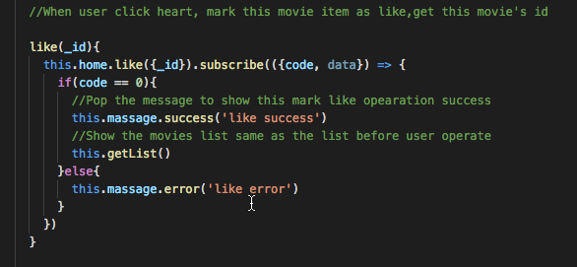
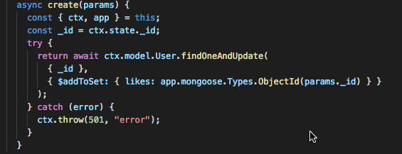
Like movie at home page
Front End
Collection Management
Likes(array, a key of user)
Movie_id
Movie_id
Movie_id
Add movie in likes
mongo
User(a collection)
Angular
Movie1
Movie2
Movie3

Slide 20
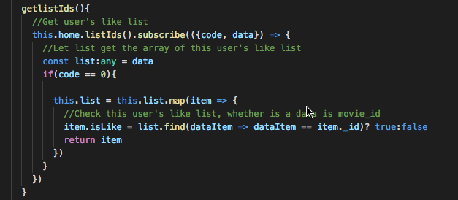
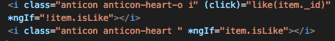
Show movie’s like at home page
Front End
Collection Management
Likes(array, a key of user)
Movie_id
Movie_id
Movie_id
mongo
User(a collection)
Angular
Islike？
Islike？
Islike？
True
False
True
Movie1
Movie2
Movie3

Slide 21
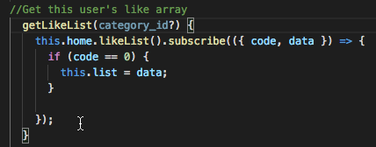
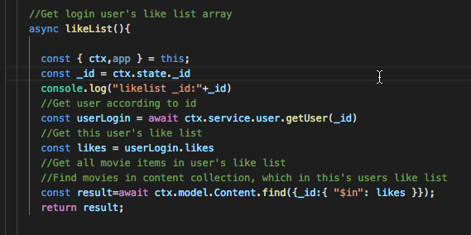
Populate liked movie(s) in collection
Front End
Collection Management
Enter like page
User(a collection)
Likes(array, a key of user)
Movie_id
Movie_id
Movie_id
mongo

Slide 22
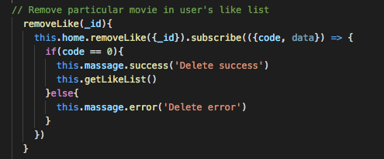
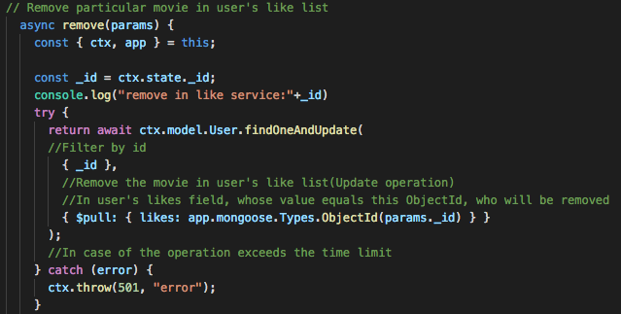
Delete liked movie from collection
Front End
Collection Management
Likes(array, a key of user)
Movie_id
Movie_id
Movie_id
Delete movie in likes
mongo
User(a collection)
Angular
Movie1
Movie2
Movie3

Slide 23
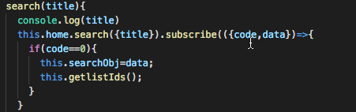
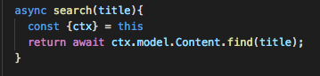
Front End
Search

Slide 24
THANKS

